Slide 1




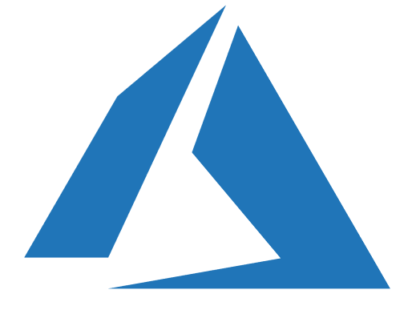










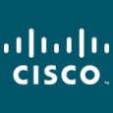
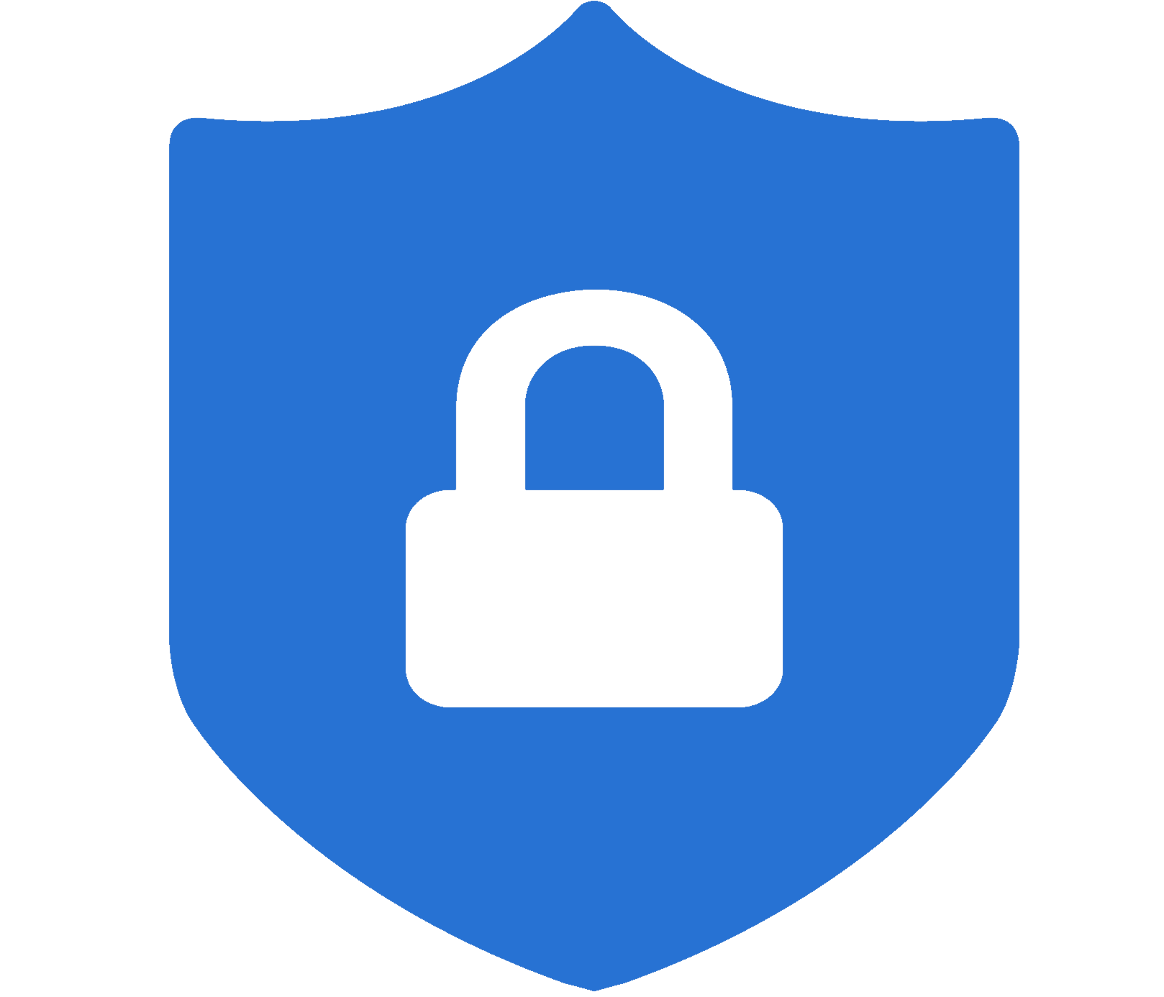
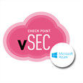

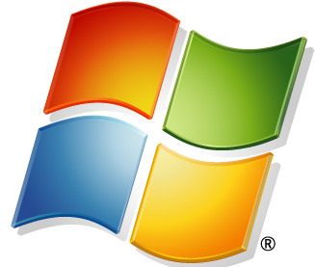

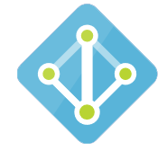


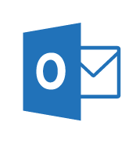
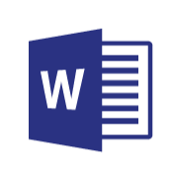
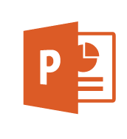
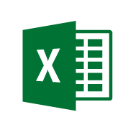
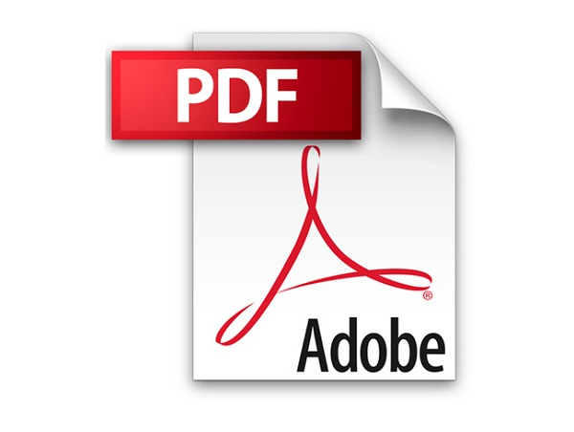





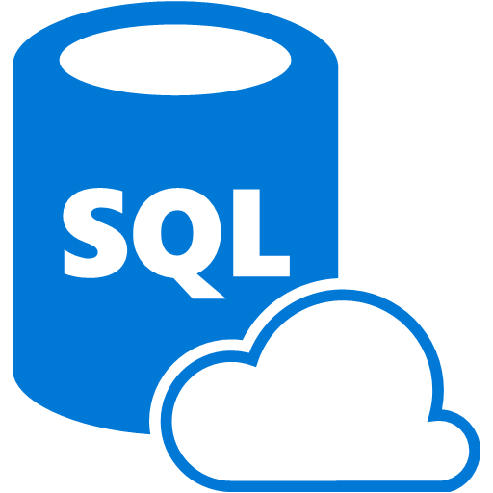
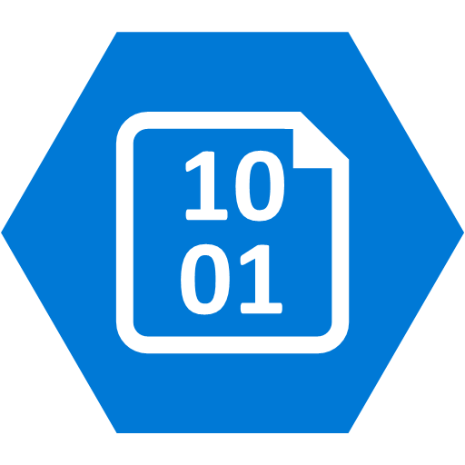
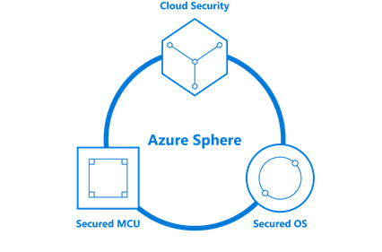


Security Operations Center (SOC)
Cybersecurity Reference Architecture
April 2019 – https://aka.ms/MCRA | Video Recording | Strategies
Software as a Service
Microsoft Threat Experts
Incident Response, Recovery, & CyberOps Services
Office 365
Azure Sentinel – Cloud Native SIEM and SOAR (Preview)
Secure Score
Vuln Mgmt
Cloud App
Security
Azure
Security Center
Microsoft Defender
Office 365
Azure
This is interactive!
Present Slide
Hover for Description
Click for more information
Roadmaps and Guidance
Securing Privileged Access
Office 365 Security
Rapid Cyberattacks (Wannacrypt/Petya)
Customer Lockbox
Advanced Threat Protection (ATP)
Dynamics 365
MSSP
Identity & Access
Graph Security API – 3rd Party Integration
Information Protection
Azure Active Directory
Alert & Log Integration
Conditional Access – Identity Perimeter Management
Clients
Hybrid Cloud Infrastructure
Cloud App Security
Azure AD Identity Protection
Leaked cred protection
Behavioral Analytics
Unmanaged &
Mobile Devices
On Premises Datacenter(s)
3rd party IaaS
Microsoft Azure
Azure Information Protection (AIP)
Discover
Classify
Protect
Monitor
Azure Security Center – Cross Platform Visibility, Protection, and Threat Detection
Configuration Hygiene
Just in Time VM Access
Azure AD PIM
NGFW
Azure Firewall
Security Appliances
Adaptive App Control
Classification Labels
Multi-Factor Authentication
Intune MDM/MAM
Managed Clients
Extranet
Edge DLP
Azure Policy
Hold Your Own Key (HYOK)
Azure AD B2B
SSL Proxy
Azure Key Vault
AIP Scanner
Azure AD B2C
IPS/IDS
Hello for Business
Express Route
Azure WAF
System Center Configuration Manager
Windows Server 2019 Security
Window 10 + Just Enough Admin, Hyper-V Containers, Nano server, and more…
Azure Antimalware
Office 365
Data Loss Protection
Data Governance
eDiscovery
MIM PAM
Microsoft Defender ATP
Application & Network Security Groups
Azure ATP
Shielded VMs
VMs
Intranet Servers
Backup & Site Recovery
Azure Stack
Azure SQL
Threat Detection
Active Directory
Secure Score
Threat Analytics
Privileged Access Workstations (PAWs)
Disk & Storage Encryption
SQL Encryption & Data Masking
ESAE Admin Forest
Windows 10 Enterprise Security
IoT and Operational Technology
Included with Azure (VMs/etc.)
Premium Security Feature
Confidential Computing
Azure SQL Info Protection
Network protection
Credential protection
Exploit protection
Reputation analysis
Full Disk Encryption
Attack surface reduction
App control
Isolation
Antivirus
Behavior monitoring
DDoS attack Mitigation+Monitor
Windows 10 IoT
Azure Sphere
IoT Security Maturity Model
Microsoft Defender ATP
Azure IoT Security
IoT Security Architecture
Compliance Manager
S Mode
Security Development Lifecycle (SDL)
Trust Center
Intelligent Security Graph
Notes:
STATIC SLIDE VERSION (No Animations)
The Microsoft Cybersecurity Reference Architecture (https://aka.ms/MCRA) describes Microsoft’s cybersecurity capabilities and how they integrate with existing security architectures and capabilities. We recently updated this diagram and wanted to share a little bit about the changes and the document itself to help you better utilize it.
How to use it
We have seen this document used for several purposes by our customers and internal teams (beyond a geeky wall decoration to shock and impress your cubicle neighbors :-)
Starting template for a security architecture - The most common use case we see is that organizations use the document to help define a target state for cybersecurity capabilities. Organizations find this architecture useful because it covers capabilities across the modern enterprise estate that now spans on-premise, mobile devices, many clouds, and IoT / Operational Technology.
Comparison reference for security capabilities - We know of several organizations that have marked up a printed copy with what capabilities they already own from various Microsoft license suites (many customers don't know they own quite a bit of this technology), which ones they already have in place (from Microsoft or partner/3rd party), and which ones are new and could fill a need.
Learn about Microsoft capabilities - In presentation mode, each capability has a "ScreenTip" with a short description of each capability + a link to documentation on that capability to learn more.
Learn about Microsoft's integration investments - The architecture includes visuals of key integration points with partner capabilities (e.g. SIEM/Log integration, Security Appliances in Azure, DLP integration, and more) and within our own product capabilities among (e.g. Advanced Threat Protection, Conditional Access, and more).
Learn about Cybersecurity - We have also heard reports of folks new to cybersecurity using this as a learning tool as they prepare for their first career or a career change.
As you can see, Microsoft has been investing heavily in security for many years to secure our products and services as well as provide the capabilities our customers need to secure their assets. In many ways, this diagram reflects Microsoft massive ongoing investment into cyber security research and development, currently over $1 billion annually (not including acquisitions).
What has changed and why
This evolves over time, so here are a few highlights on what's changed as well as the underlying philosophy of how this document was built.
Version 3.1 (April 2019)
Updated Windows Defender ATP to Microsoft Defender ATP
Corrected links/descriptions for Azure AD B2B and B2C
Corrected date on main slide
Version 3 (March 2019)
Added Azure Sentinel – This is the cloud native SIEM + SOAR solution that Microsoft built into Azure
Added Defender ATP to information protection – Now that this capability is integrated with both Azure Information Protection and Microsoft Cloud App Security, it becomes a very compelling replacement for a traditional host based DLP solution.
Added Azure Firewall – This technology is maturing quickly and becoming a potential replacement for traditional NGFWs in Azure for some scenarios
Added lines to the various capabilities that integrate with the classification labels in information protection.
Version 2 (June 2018)
New visual style - The most obvious change for those familiar with the first version is the simplified visual style. While some may miss the "visual assault on the senses" effect from the bold colors in v1, we think this format works better for most people.
Interactivity instructions - Many people did not notice that each capability on the architecture has a quick description and link to more information, so we added instructions to call that out (and updated the descriptions themselves).
Complementary Content - Microsoft has invested in creating cybersecurity reference strategies (success criteria, recommended approaches, how our technology maps to them) as well as prescriptive guidance for addressing top customer challenges like Petya/WannaCrypt, Securing Privileged Access, and Securing Office 365. This content is now easier to find with links at the top of the document.
Added Section headers for each grouping of technology areas to make it easier to navigate, understand, and discuss as a focus area.
Added Foundational Elements - We added descriptions of some core foundational capabilities that are deeply integrated into how we secure our cloud services and build our cybersecurity capabilities that have been added to the bottom. These include
Trust Center - This is where describe how we secure our cloud and includes links to various compliance documents such as 3rd party auditor reports.
Compliance Manager is a powerful (new) capability to help you report on your compliance status for Azure, Office 365, and Dynamics 365 for General Data Protection Regulation (GDPR), NIST 800-53 and 800-171, ISO 27001 and 27018, and others.
Intelligent Security Graph is Microsoft threat intelligence system that we use to protect our cloud, our IT environment, and our customers. The graph is composed of trillions of signals, advanced analytics, and teams of experts hunting for malicious activities and is integrated into our threat detection and response capabilities.
Security Development Lifecycle (SDL) is foundational to how we develop software at Microsoft and has been published to help you secure your applications. Because of our early and deep commitment to secure development, we were able to quickly conform to ISO 27034 after it was released.
Moved Devices/Clients together - As device form factors and operating systems continue to expand and evolve, we are seeing security organizations view devices through the lens of trustworthiness/integrity vs. any other attribute.
We also re-organized the Windows 10 and Windows Defender ATP capabilities around outcomes vs. feature names for clarity.
We also reorganized windows security icons and text to reflect that Windows Defender ATP describes all the platform capabilities working together to prevent, detect, and (automatically) respond and recover to attacks. We also added icons to show the cross-platform support for Endpoint Detection and Response (EDR) capabilities that now extend across Windows 10, Windows 7/8.1, Windows Server, Mac OS, Linux, iOS, and Android platforms.
We also faded the intranet border around these devices because of the ongoing success of phishing, watering hole, and other techniques that have weakened the network boundary.
Updated SOC section - We moved several capabilities from their previous locations around the architecture into the Security Operations Center (SOC) as this is where they are primarily used. This move enabled us to show a clearer vision of a modern SOC that can monitor and protect the hybrid of everything estate. We also added the Graph Security API (in public preview) as this API is designed to help you integrate existing SOC components and Microsoft capabilities.
Simplified server/datacenter view - We simplified the datacenter section to recover the space being taken up by duplicate server icons. We retained the visual of extranets and intranets spanning on-premises datacenters and multiple cloud provider(s). Organizations see Infrastructure as a Service (IaaS) cloud providers as another datacenter for the intranet generation of applications, though they find Azure is much easier to manage and secure than physical datacenters. We also added Azure Stack capability that allows customers to securely operate Azure services in their datacenter.
New IoT/OT section - IoT is on the rise on many enterprises due to digital transformation initiatives. While the attacks and defenses for this area are still evolving quickly, Microsoft continues to invest deeply to provide security for existing and new deployments of Internet of Things (IoT) and Operational Technology (OT). Microsoft has announced $5 billion of investment over the next four years for IoT and has also recently announced an end to end certification for a secure IoT platform from MCU to the cloud called Azure Sphere.
Updated Azure Security Center - Azure Security Center grew to protect Windows and Linux operating system across Azure, on-premises datacenters, and other IaaS providers. Security Center has also added powerful new features like Just in Time access to VMs and applied machine learning to creating application whitelisting rules and North-South Network Security Group (NSG) network rules.
Added Azure capabilities including Azure Policy, Confidential Computing, and the new DDoS protection options.
Added Azure AD B2B and B2C - Many Security departments have found these capabilities useful in reducing risk by moving partner and customer accounts out of enterprise identity systems to leverage existing enterprise and consumer identity providers.
Added information protection capabilities for Office 365 as well as SQL Information Protection (preview).
Updated integration points - Microsoft invests heavily to integrate our capabilities together as well as to ensure use our technology with your existing security capabilities. This is a quick summary of some key integration points depicted in the reference architecture:
Conditional Access connecting info protection and threat protection with identity to ensure that authentications are coming from a secure/compliant device before accessing sensitive data.
Advanced Threat Protection integration across our SOC capabilities to streamline detection and response processes across Devices, Office 365, Azure, SaaS applications, and on Premises Active Directory.
Azure Information Protection discovering and protecting data on SaaS applications via Cloud App Security.
Data Loss Protection (DLP) integration with Cloud App Security to leverage existing DLP engines and with Azure Information Protection to consume labels on sensitive data.
Alert and Log Integration across Microsoft capabilities to help integrate with existing Security Information and Event Management (SIEM) solution investments.
Feedback
We are always trying to improve everything we do at Microsoft and we need your feedback to do it! You can contact the primary author (Mark Simos) directly on LinkedIn (https://aka.ms/markslist) with any feedback on how to improve it or how you use it, how it helps you, or any other thoughts you have.

Slide 2
Security Operations Center (SOC)
Cybersecurity Reference Architecture
April 2019 – https://aka.ms/MCRA | Video Recording | Strategies
Software as a Service
Microsoft Threat Experts
Incident Response, Recovery, & CyberOps Services
Office 365
Security Information and Event Management (SIEM)
Analytics/Automation
Secure Score
Azure Sentinel – Cloud Native SIEM and SOAR (Preview)
Vuln Mgmt
Cloud App
Security
Azure
Security Center
Microsoft Defender
Office 365
Azure
This is interactive!
Present Slide
Hover for Description
Click for more information
Roadmaps and Guidance
Securing Privileged Access
Office 365 Security
Rapid Cyberattacks (Wannacrypt/Petya)
Customer Lockbox
Advanced Threat Protection (ATP)
Dynamics 365
MSSP
Identity & Access
Graph Security API – 3rd Party Integration
Information Protection
Azure Active Directory
Alert & Log Integration
Conditional Access – Identity Perimeter Management
Clients
Hybrid Cloud Infrastructure
Cloud App Security
Azure AD Identity Protection
Leaked cred protection
Behavioral Analytics
Unmanaged &
Mobile Devices
On Premises Datacenter(s)
3rd party IaaS
Microsoft Azure
Azure Information Protection (AIP)
Discover
Classify
Protect
Monitor
Azure Security Center – Cross Platform Visibility, Protection, and Threat Detection
Configuration Hygiene
Just in Time VM Access
Azure AD PIM
NGFW
Azure Firewall
Security Appliances
Adaptive App Control
Classification Labels
Multi-Factor Authentication
Intune MDM/MAM
Managed Clients
Extranet
Edge DLP
Azure Policy
Hold Your Own Key (HYOK)
Azure AD B2B
SSL Proxy
Azure Key Vault
AIP Scanner
Azure AD B2C
IPS/IDS
Hello for Business
Express Route
Azure WAF
System Center Configuration Manager
Windows Server 2019 Security
Window 10 + Just Enough Admin, Hyper-V Containers, Nano server, and more…
Azure Antimalware
Office 365
Data Loss Protection
Data Governance
eDiscovery
MIM PAM
Microsoft Defender ATP
Application & Network Security Groups
Azure ATP
Shielded VMs
VMs
Intranet Servers
Backup & Site Recovery
Azure Stack
Azure SQL
Threat Detection
Active Directory
Secure Score
Threat Analytics
Privileged Access Workstations (PAWs)
Disk & Storage Encryption
SQL Encryption & Data Masking
ESAE Admin Forest
Windows 10 Enterprise Security
IoT and Operational Technology
Included with Azure (VMs/etc.)
Premium Security Feature
Confidential Computing
Azure SQL Info Protection
Network protection
Credential protection
Exploit protection
Reputation analysis
Full Disk Encryption
Attack surface reduction
App control
Isolation
Antivirus
Behavior monitoring
DDoS attack Mitigation+Monitor
Windows 10 IoT
Azure Sphere
IoT Security Maturity Model
Microsoft Defender ATP
Endpoint DLP
Azure IoT Security
IoT Security Architecture
Compliance Manager
S Mode
Security Development Lifecycle (SDL)
Trust Center
Intelligent Security Graph
Notes:
BUILD SLIDE VERSION (Animated Build sequence that takes ~25 clicks)
Key Takeaway: This is the Microsoft Cybersecurity Reference Architecture (https://aka.ms/MCRA) which describes Microsoft’s cybersecurity capabilities and how they integrate with existing security architectures and capabilities.
The latest version of this diagram, associated presentation video (on v1 version currently), and the complementary cybersecurity reference strategies can be found at the links at the top. Links to key guidance are also included for important and complex initiatives like securing privileged access, Office 365, and protecting against attack like Petya/Wannacrypt.
This diagram is interactive, you can hover over any of the capabilities for a quick description and then click on it for more documentation on the capability.
CLICK 1
Most enterprise organizations have Windows and Linux servers (and often applications containers) to protect. Most have also established a basic core set of security capabilities at the network edge / egress points to protect extranet and intranet resources.
CLICK 2
We also commonly find that enterprises also have a range of client devices to support and protect ranging from corporate issued PCs to Bring Your Own Device (BYOD) personally owned mobile devices.
CLICK 3
Many enterprise organizations have established an operational security capability that includes vulnerability management and incident management, which is typically provided by an on-premises Security Information Event Management (SIEM) capability or a Managed Security Services Provider (MSSP).
CLICK 4
Many have also deployed endpoint Data Loss Prevention (DLP) capability to help with information protection needs.
CLICK 5
Most larger organizations have Active Directory as a primary enterprise directory (frequently as part of an identity system that includes other capabilities for identity lifecycle management, credential vaulting, and other needs)
CLICK 6
Most enterprises estates include Software as a Service (SaaS) like Office 365 and other popular services. Some of these are sanctioned and configured by corporate IT, but others are “Shadow IT” adopted by business units and individual user without the knowledge or endorsement of corporate IT.
CLICK 7
Many organizations also operate traditional Industrial Control Systems (ICS) including Supervisory Control and Data Acquisition (SCADA) technology. Many are also operating or planning to adopt Internet of Things (IoT) technology for both internal systems and customer product offerings.
CLICK 8
Additionally, the scope of enterprise infrastructure has grown into a hybrid state that incorporates Infrastructure as a Service (IaaS) and Platform as a Service (PaaS) from Microsoft Azure as well as other IaaS providers.
Pausing for a moment, this leaves most enterprises with a “hybrid of everything” estate to manage and secure, which is quite challenging given the steadily increasing volume and sophistication of cybersecurity threat actors.
CLICK 9
The foundation of Microsoft’s cloud services and products starts with our investments in security and compliance, many of which have been made available to our customers in some form:
Trust Center – Microsoft offers the most comprehensive set of compliance offerings of any cloud service provider. We transparently provide information on how we meet or exceed those standards in our trust center.
Compliance Manager - We built a capability to help you manage your compliance requirements (based heavily on what we learned while managing compliance of our cloud services such as an extensive mapping of controls across standards)
Security Development Lifecycle - We have also published documentation from our industry leading security development lifecycle openly to help you with securing your applications. This has recently evolved into a Secure DevOps toolkit for Azure - https://azsk.azurewebsites.net/
Intelligence Security Graph – Through the course of supporting, operating, and securing our cloud services and Windows PCs, Microsoft has accumulated a massive set of first party threat intelligence (processes about 6.5 trillion signals per day) that we use to protect our cloud services, IT environment, and customers. Many of the products in this architecture have integrated intelligence and analytics from the security graph directly into threat detection and alert enrichment capabilities.
CLICK 10
Familiar security capabilities from popular vendors are available in the Azure Marketplace to enable customers to extend on premises controls to the cloud. Additionally, Microsoft has built Azure Firewall, a native “Firewall as a Service” capability in Azure that includes several advanced technologies and greatly simplifies firewall deployment and management.
CLICK 11
Microsoft has invested into Azure Security Center (ASC) to enable you to
Protect servers and workloads
Detect and correct common misconfiguration issues such as
VMs exposed directly to the internet
Missing Web Application Firewalls (WAFs) for web applications
Out of date patches and antimalware signatures
…and many others
Leverage cutting edge capabilities in Azure like machine learning to suggest firewall rules and application whitelists (to allow/block which files can run on servers)
CLICK 12
Microsoft has also invested heavily in other Azure security capabilities such as Distributed Denial of Service (DDoS) mitigations, key management, ransomware-resistant backup archives, confidential computing capabilities to protect data while its being processed, and many more.
CLICK 13
Microsoft has also continued to invest into on-premises security capabilities for Windows Server (including Shielded VMs) and Azure Stack (which provides the ability to run Azure services in your on-premises datacenter)
CLICK 14
Microsoft has also focused heavily on device security with
System Center Configuration Manager and Intune MDM/MAM for cross platform security and management across Windows, Linux, Mac, iOS, and Android
Windows 10 Enterprise Security - An extensive set of platform capabilities to protect against ever-evolving attacks
Windows Defender ATP – Advanced endpoint detection and response (EDR) capabilities to rapidly detect and recover from attacks as well as management, monitoring, and security planning capabilities to keep devices healthy and secure.
CLICK 15
Based on lessons learned from credential theft and similar attacks, Microsoft has invested in securing privilege access including privileged access management, advanced credential/identity attack detection and privileged access workstation (PAW) architectures. Our PAW investments includes
Publishing Guidance – We have published detailed installation instructions for customers to build their own PAWs
Platform Security – We protect our IT Environment and cloud services with a full admin workstation program (internally called Secure Access Workstations or SAWs)
CLICK 16
Because of how critical identity is to security, Microsoft has invested heavily in security capabilities to protect and manage cloud and on-premises identities spanning multi-factor authentication, biometrics, hardware protection of credentials (via TPM and virtualization based security), applying threat intelligence + machine learning to authentication attempts, and more.
CLICK 17
Identity is also critical for protecting data and operational availability as it’s frequently the only control type available across modern IoT/mobile/etc. devices and cloud services. Organizations should focus on build an identity security perimeter to consolidate management of authentication and access controls and enforce consistency. Microsoft has invested into Conditional Access to enable simple (and powerful) visibility and policy control of this new perimeter.
CLICK 18
Microsoft has invested across our tools to enable integration with your existing Security Information and Event Management (SIEM) solution.
CLICK 19
Microsoft has built Advanced Threat Protection (ATP) technology to provide deep context on key technical elements of the modern estate (Endpoint, Identity, Email, and more) to rapidly detect and remediate threats across them. Microsoft also offers professional services to help you investigate incidents in your environment as well as to hunt for potential existing threats. This will enable you to transform your SOC using the massive set of Microsoft threat intelligence in the intelligent security graph (bottom right of slide) and integrate these with your existing capabilities using the Graph Security API.
CLICK 20
Microsoft also built Azure Sentinel, a cloud native SIEM and SOAR capability, into Azure to help you with breadth of visibility to collect security data from across your enterprise estate including Microsoft, AWS, other clouds, and on premises assets. Azure Sentinel uses machine learning to reduce alert fatigue (up to 90% in private preview) and native cloud capabilities (like automation) to simplify your data collection, SIEM maintenance, and incident investigation + remediation.
CLICK 21
Microsoft has built several Office 365 security capabilities to enhance your security planning (Secure Score), add additional explicit approval steps before Microsoft support can access your data for support issues (Customer Lockbox), and data protection technologies built into the platform.
CLICK 22
Azure Information Protection – Protects information at the file itself so the encryption and policy control can follow files wherever they go (Cloud, Devices, USB drives, etc.).
CLICK 23
Cloud App Security is a Microsoft Cloud Application Security Broker (CASB) offering that provides a wide array of security capabilities for SaaS including Shadow IT Risk management, Policy Monitoring and Enforcement, Information Protection, and incident detection/response/recovery.
CLICK 24
Additionally, Microsoft has invested in advanced security capabilities for data in SQL to protect against common threats and simplify information protection management and policy.
CLICK 25
Microsoft is also investing heavily into OT and IoT security to help manage and secure existing (brownfield) platforms, provide secure (greenfield) platforms, and help manufacturers quickly determine what level of security they need and enable them to rapidly and easily achieve that.
CLICK 26
We understand this is a lot of capabilities to plan for, so we have built several prescriptive roadmaps to help organizations quickly mitigate risk from critical and complex cybersecurity challenges.
Feedback
We are always trying to improve everything we do at Microsoft and we need your feedback to do it! You can contact the primary author (Mark Simos) directly on LinkedIn (https://aka.ms/markslist) with any feedback on how to improve it or how you use it, how it helps you, or any other thoughts you have.

